Slide 1
COMP 4500
Week 3 - Friday

Slide 2
Last time
What did we talk about last time?
Trees
Graph connectivity
Breadth-first search
Representing graphs

Slide 3
Questions?

Slide 4
Depth First Search

Slide 5
Queues and stacks
A queue is a set where we extract elements in first-in, first-out (FIFO) order
A stack is a set where we extract elements in last-in, first-out (LIFO) order
Both data structures can be efficiently implemented by a doubly-linked list

Slide 6
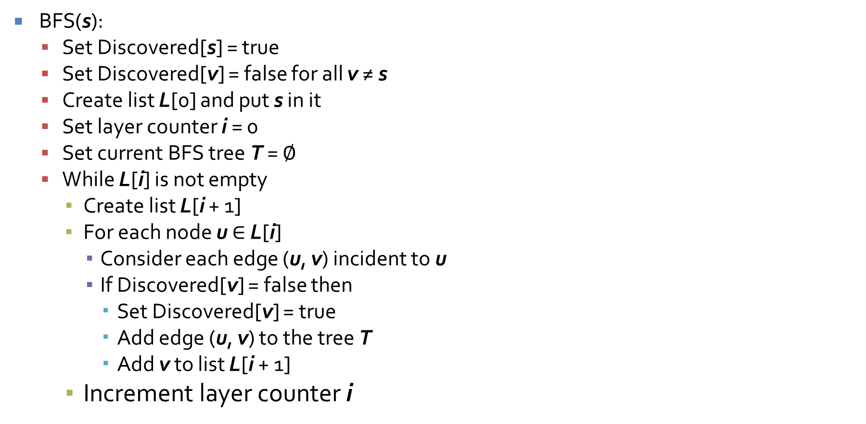
Implementing BFS
BFS(s):
  Set Discovered[s] = true
  Set Discovered[v] = false for all v ≠ s
  Create list L[0] and put s in it
  Set layer counter i = 0
  Set current BFS tree T = $∅$
  While L[i] is not empty
    Create list L[i + 1]
    For each node u ∈ L[i]
      Consider each edge (u, v) incident to u
      If Discovered[v] = false then
        Set Discovered[v] = true
        Add edge (u, v) to the tree T
        Add v to list L[i + 1]
    Increment layer counter i

Slide 7
Running time for BFS
Weak bound: O(n²)
We have at most n lists L[i], taking O(n) time to set up
Each node occurs at most once in any list, so the total iterations of the For loops in the While is n
When we consider a node u, it has at most n edges, each of which can be processed in constant time
n iterations of the For loop taking at most O(n) time each gives O(n²) time

Slide 8
Better running time for BFS
Stronger bound: O(n + m)
The argument is the same except that there might be fewer than n² edges
The total number of edges considered (in an adjacency list representation) for all nodes u is 2m (because each edge is seen twice)
Total time then is O(n) set-up, O(n) nodes checked, and O(m) edges checked, giving O(n + m) time

Slide 9
Implementing DFS (non-recursively)
DFS(s):
  Create stack S and put s in it
  While S is not empty
    Take a node u from S
    If Explored[u] = false then
      Set Explored[u] = true
      For each edge (u, v) incident to u
        Add v to the stack S

Slide 10
Notes about DFS
Because the stack is FILO, we will actually process the adjacency list in reverse order from the recursive version of DFS
We can find the DFS tree by adding a parent array to the algorithm
  When we add node v to the stack because of edge (u, v), we set parent[v] = u
  When we mark any node u (other than s) as Explored, we add edge (u, parent[u]) to the DFS tree

Slide 11
Running time for DFS
Again, we can get O(n + m) time
Adding and removing from the stack can be done in constant time
A node will get added to the stack every time one of its adjacent nodes is explored
The total number of nodes added (and removed) is bounded by the total degree of the graph, 2m
Running time is then O(n + m)

Slide 12
Finding all connected components
Using either BFS or DFS, you will only find the connected component containing s
We can keep running either until we find all connected components
The running time O(n + m) is actually based only on the nodes and edges in a particular connected component
Finding all connected components will still only take O(n + m) for the whole graph

Slide 13
Three-Sentence Summary of Testing for Bipartiteness, Directed Connectivity, and Topological Sort

Slide 14
Testing for Bipartiteness

Slide 15
Bipartiteness
Recall the definition of a bipartite graph:
  A graph that can be partitioned into sets X and Y such that every edge has one end in X and the other in Y
  Or, you can think of nodes in set X as red and nodes in set Y as blue
An alternative, equivalent definition of a bipartite graph is one that has no odd cycles

Slide 16
Detecting bipartiteness
Pick a node and color it blue
Color all of its neighbors red
Keep going, coloring neighbors, alternating which color you use
  Don't change the color of a node if it's already colored
If there are any edges that start and end in the same color, it's not bipartite
This algorithm is essentially BFS where, when adding a node to layer L[i + 1], we color it red when i + 1 is even and blue when i + 1 is odd

Slide 17
Layer lemma
Let T be a breadth-first search tree, let x and y be nodes in T belonging to layers L_{i} and L_{j} respectively, and let (x, y) be an edge of G.
Then i and j differ by at most 1.
Proof by contradiction:
  Suppose i and j differ by more than one. Assume that i < j – 1. Since x is in layer L_{i}, the only nodes discovered from x belong to layers L_{i + 1} and earlier. If y is a neighbor of x, it should have been discovered and put in layer L_{i + 1} or earlier.

Slide 18
Claim of correctness
Let G be a connected graph, and let L₁, L₂, … be the layers produced by BFS starting at node s. Exactly one of the following two things must hold:
There is no edge of G joining two nodes of the same layer. In this case G is a bipartite graph in which the nodes in even-numbered layers can be colored red, and the nodes in odd-numbered layers can be colored blue.
There is an edge of G joining two nodes of the same layer. In this case, G contains an odd-length cycle, and so it cannot be bipartite.

Slide 19
Proof of correctness
Case 1. No edges join two nodes in the same layer. By the Layer Lemma, every edge of G joins nodes either in the same layer or in adjacent layers. Since no edges join nodes in the same layer, they always join nodes in adjacent layers, with different colorings. Thus, G is bipartite.

Slide 20
Proof of correctness (continued)
Case 2: At least one edge joins two nodes of the same layer, x and y. Let x and y be in layer L_{j}. Let z be the node with the highest layer number possible while still being an ancestor of x and y in the BFS tree. Let z be in layer L_{i}, where i < j. There is a cycle in G from z down to x, from x to y, and then from y back to z. The length of the cycle is (j – i) + 1 + (j – i) = 2(j – i) + 1, which is odd. Thus, the graph is not bipartite.

Slide 21
Directed Connectivity

Slide 22
Directed graph representations
It can be useful to extend the adjacency list representation for directed graphs
As before, for node u, we have a list of nodes that u connects to
But we add a second list of nodes that connect to u as well
In this way, we can efficiently determine all nodes that can reach u

Slide 23
Directed DFS and BFS
We can run DFS or BFS on a directed graph starting at s
Instead of getting a connected component, we will get a tree of nodes reachable from s
  Not all nodes will necessarily have a path back to s
We can also run DFS on reversed edges, yielding the tree of nodes that can reach s

Slide 24
Strong connectivity
A directed graph is strongly connected if, for all nodes u and v, there is a path from u to v and a path from v to u
Nodes u and v are mutually reachable if you can reach u from v and v from u
If u and v are mutually reachable and v and w are mutually reachable, then u and w are mutually reachable

Slide 25
Strong components
To see if a graph is strongly connected, pick a node s and run BFS from it
Then run BFS on the reversed edge graph
If both searches visit every node, it's strongly connected
A strong component containing s is the set of all nodes v such that s and v are mutually reachable
For any two nodes s and t in a directed graph, their strong components are either identical or disjoint

Slide 26
Topological Sort

Slide 27
Directed acyclic graph
A directed acyclic graph (DAG) is a directed graph without cycles in it
These can be used to represent dependencies between tasks
An edge flows from the task that must be completed first to a task that must come after
A cycle in such a graph would mean there was a circular dependency
By running topological sort, we discover if a directed graph has a cycle, as a side benefit

Slide 28
Topological sort
A topological sort gives an ordering of the tasks such that all tasks are completed in dependency ordering
In other words, no task is attempted before its prerequisite tasks have been done
There are usually multiple legal topological sorts for a given DAG

Slide 29
Quiz

Slide 30
Upcoming

Slide 31
Next time…
Finish topological sort
Greedy algorithms
Scheduling

Slide 32
Reminders
Work on Assignment 2
  Due next Friday before midnight
Read sections 4.1 and 4.2

